Slide 1
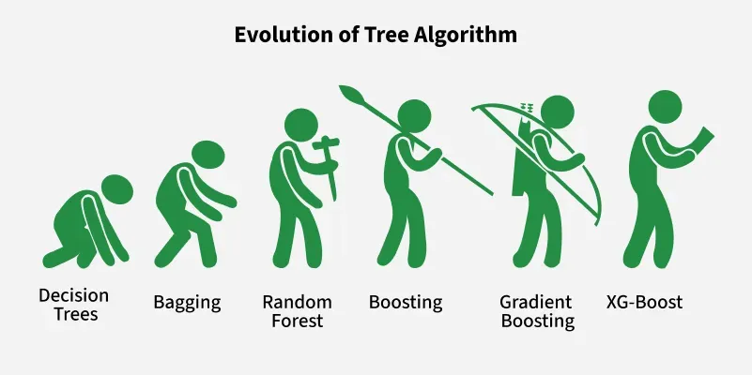
Introduction to XGBoost
Overview of the Adaptive Boosting Algorithm
Presented by: [DEEPIKA NARENDRAN]
Date: [Friday May 2025]

Slide 2
What is XGBoost ?
Traditional machine learning models like decision trees and random forests are easy to interpret but often struggle with accuracy on complex datasets.
XGBoost short form for eXtreme Gradient Boosting is an advanced machine learning algorithm designed for efficiency, speed and high performance.
It is an optimized implementation of Gradient Boosting and is a type of ensemble learning method that combines multiple weak models to form a stronger model.
XGBoost uses decision trees as its base learners and combines them sequentially to improve the model’s performance. Each new tree is trained to correct the errors made by the previous tree and this process is called boosting.
It has built-in parallel processing to train models on large datasets quickly. XGBoost also supports customizations allowing users to adjust model parameters to optimize performance based on the specific problem.

Slide 3
How XGBoost Works
It builds decision trees sequentially with each tree attempting to correct the mistakes made by the previous one. The process can be broken down as follows:
* Start with a base learner: The first model decision tree is trained on the data. In regression tasks this base model simply predicts the average of the target variable.
* Calculate the errors: After training the first tree the errors between the predicted and actual values are calculated.
* Train the next tree: The next tree is trained on the errors of the previous tree. This step attempts to correct the errors made by the first tree.
* Repeat the process: This process continues with each new tree trying to correct the errors of the previous trees until a stopping criterion is met.
* Combine the predictions: The final prediction is the sum of the predictions from all the trees.

Slide 4
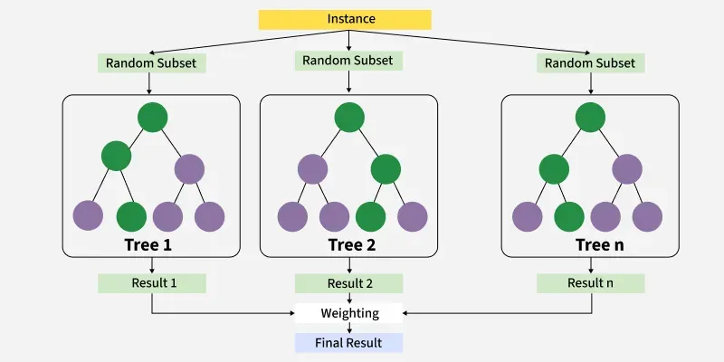
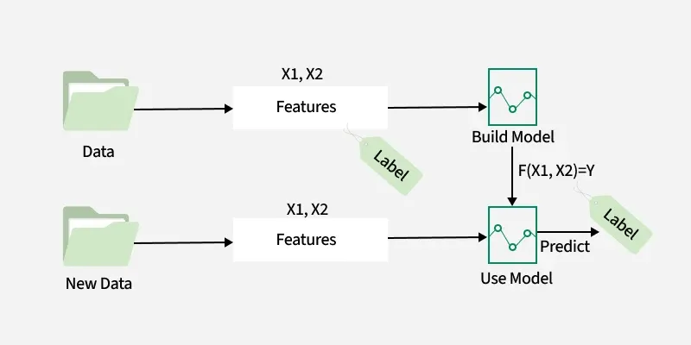
How XGBoost Works

Slide 5
Advantages and Limitations
Advantages of XGboost
Scalable and efficient for large datasets with millions of records
Supports parallel processing and GPU acceleration for faster training
Offers customizable parameters and regularization for fine-tuning
Includes feature importance analysis for better insights and selection
Trusted by data scientists across multiple programming languages
Limitations of XGBoost
XGBoost can be computationally intensive, making it less ideal for resource-constrained systems.
It may be sensitive to noise or outliers, requiring careful data preprocessing.
Prone to overfitting, especially on small datasets or with too many trees.
Offers feature importance, but overall model interpretability is limited compared to simpler methods which is an issue in fields like healthcare or finance.

Slide 6
Real-World Use Cases
Fraud Detection:
XGBoost can be used to identify fraudulent transactions by analyzing patterns in financial data.
Credit Scoring:
It helps assess creditworthiness by predicting the likelihood of default based on various factors.
Customer Churn Prediction:
XGBoost can identify customers at risk of leaving, allowing businesses to take proactive measures.
Disease Prediction:
In healthcare, XGBoost can predict disease progression or the effectiveness of treatments based on patient data.
Image and Text Classification:
XGBoost can classify images and text into different categories.

